Slide 1
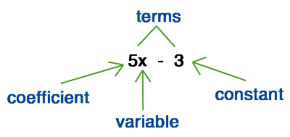
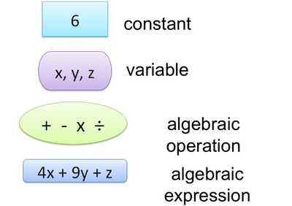
My Algebra Interactive Notebook
Name
Class
Teacher Mr Evans
Term 2 Semester 1
1

Slide 2
Contents
Glossary or Formula Page
Page
Date
Description
2
3

Slide 3
Tasks
24
7
30
Essential Question
Questions
Notes
Summary

Slide 4

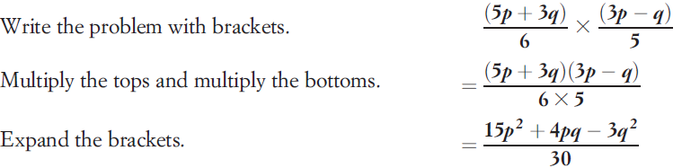
24
7
30
Date
Multiplying Algebraic Fractions
EQ – What is the difference between multiplying algebraic fractions and normal fractions?
What do I need to do when multiplying fractions?
When multiplying fractions we multiply the numerators and multiply the denominators. Where possible, we simplify first. We do exactly the same when multiplying algebraic fractions.
Example

Slide 5
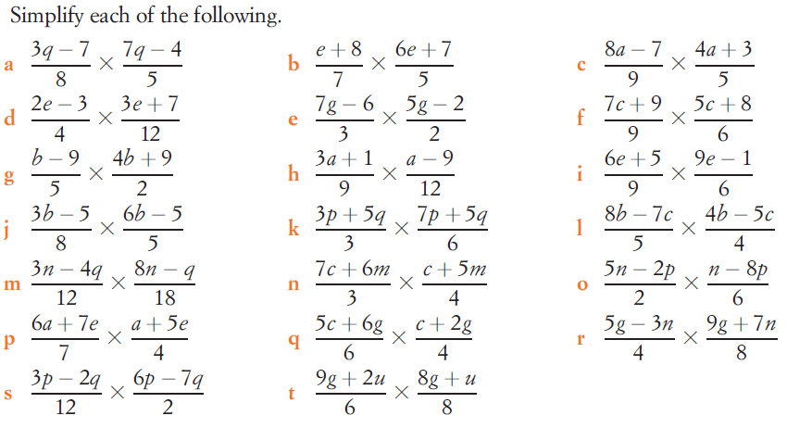
Task

Slide 6
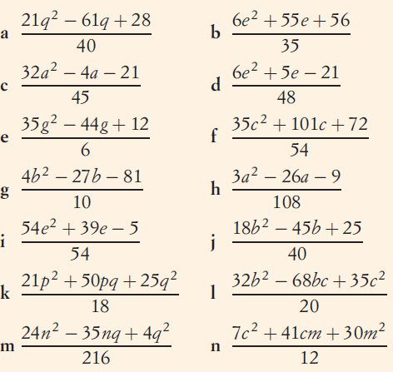
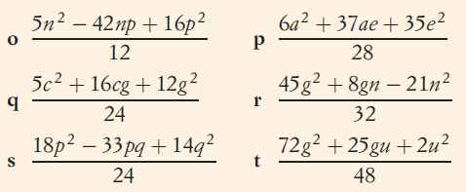
Answers

Slide 7
Notes Review
24, 7 ,30
Date
Title
Essential question
Notes complete
Notes complete with colour and diagrams
Questions completed
Contents page filed in
Formula page filled in

Slide 8
Homework
Review your notes and write a summary answering the essential question.

